Slide 1
Biological Network Analysis
Hannah Carter
UCSD Department of Medicine
02/28/2017

Slide 2
Overview
Day 1: Network analysis
Network basics
Networks and biology
Examples of biological networks
Networks & variant analysis
Networks & expression analysis
Day 2: Exercises

Slide 3

Why Networks?

Slide 4


Why Networks?
Reductionist Biology
Parts list
Study each part individually
Systems biology
Study behavior of the system
Behavior arises from interactions among components
Networks capture interactions
Better for studying complex behaviors of systems
Too much data
High throughput technologies generate so much data that more global approaches are necessary to find the important factors
Notes:
The study of the interactions between the components of biological systems, and how these interactions give rise to the function and behavior of that system

Slide 5
Network Theory
Study of graphs as a representation of the relationships between discrete objects
Genes, proteins, enzymes, metabolites, drugs, diseases, …
Objects represented as nodes, relationships represented as edges
Protein-protein interactions, enzyme-substrate relationships, co-expressed mRNAs …

Slide 6
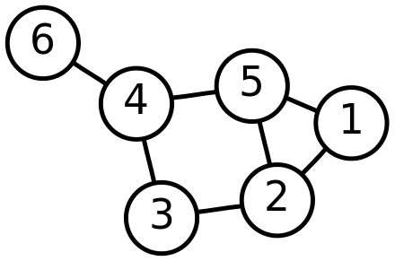
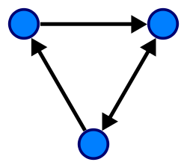
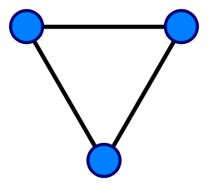
Properties of Graphs
G=(V,E)
V = vertices (nodes)
E = edges
Nodes can represent one type of entity or more
Bipartite graph
Edges can be directed or undirected (or mixed)
Different types of relationship
Subgraph – connected subset of G
V = {1, 2, 3, 4, 5, 6}
E = {{1, 2}, {1, 5}, {2, 3}, {2, 5}, {3, 4}, {4, 5}, {4, 6}}

Slide 7
Properties of a Graph
Degree
The number of edges incident on a node
In a directed graph can be divided into in-degree and out-degree
Walk
A sequence of adjacent vertices in the graph
Can also be thought of as a sequence of incident edges
Path
A walk in which no vertex occurs more than once
Shortest path
Diameter
Longest shortest path

Slide 8
Properties of Graphs
Connected components
The set of connected nodes in a graph form a connected component
Graphs can have multiple connected components
Cliques
A set of nodes that are all directly connected to one another
“Complete” subgraph of G
Motifs
Subgraphs that occur within a larger graph
Cyclic vs acyclic
Trees are graphs with no cycles
Nodes can sometimes have self loops

Slide 9
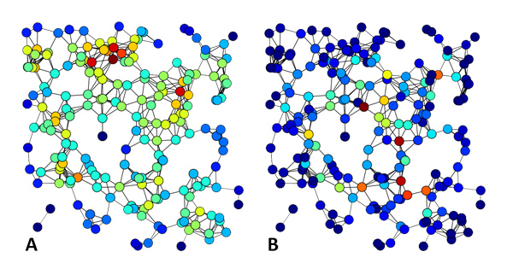
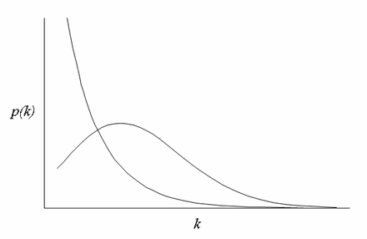
Properties of Graphs
Density – the extent to which a graph is complete
Centrality – identifies the most “important” nodes in a graph
Various measures: degree centrality, betweenness centrality, …
Assortativity – the tendency of similar nodes to interact
Often measured in terms of node degree
Scale-free – degree distribution follows a power law
Small-world – most nodes can be reached from all other nodes by traversing a small number of edges
Betweenness Centrality
Degree Centrality

Slide 10
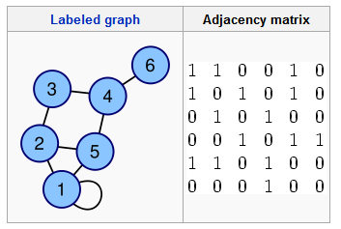
Encoding Graphs
Adjacency matrix
Can include edge weights in adjacency matrix
SIF format
1 1
1 2
1 5
2 3
2 5
3 4
4 5
4 6

Slide 11
Graphical Models for Studying Biological Systems

Slide 12
Why use graphs to analyze biology?
Analysis of biological networks have found that properties of graphs can correlated with biological function

Slide 13
Graph Properties vs Biology
Clustering Coefficient
How connected are my neighbors?
Count triangles

Slide 14
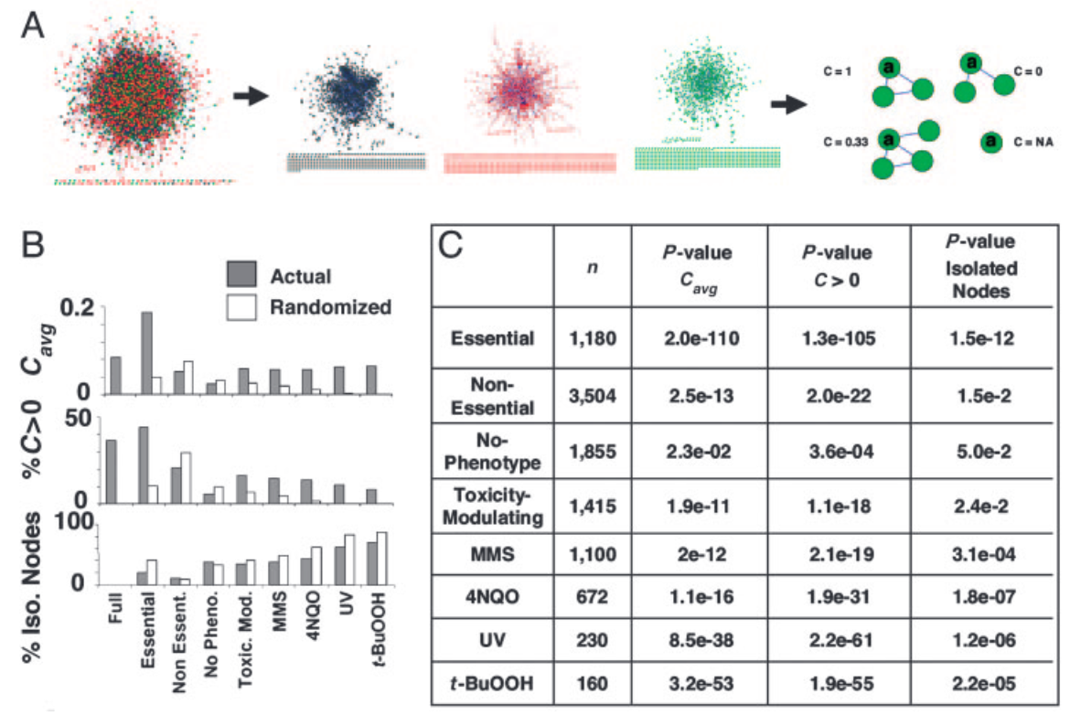
Graph Properties vs Biology
Clustering Coefficient
Essential genes have higher C(v)
Actual
Randomized
0.2
C(V) avg
0
Full Essential
Non Essent.
No Pheno.
Toxic. Mod.
Said et al PNAS 2004
Notes:
A) Derived networks:
Black – essential
Green – prevent age-induced cell death
Red – no phenotype
Essential, toxicity-modulating, and no-phenotype classifications were based on results obtained by the S. Cerevisiae Gene deletion consortium

Slide 15
Graph Properties vs Biology
Measures of centrality
Degree centrality
normalized
Closeness centrality
Eigenvector centrality
normalized eigenvector of first eigenvalue of the adjacency matrix
Between-ness centrality

Slide 16
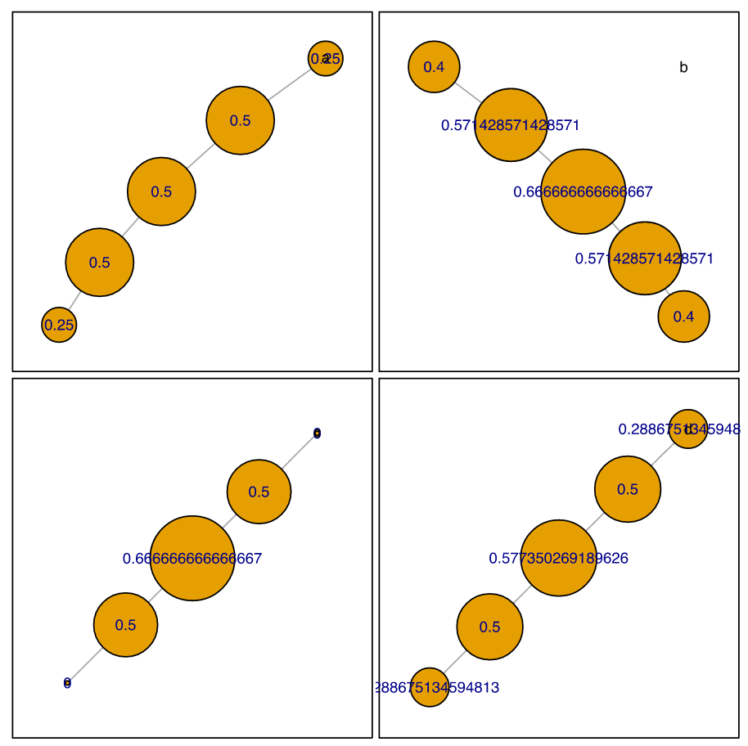
Graph Properties vs Biology
Degree
Closeness
Centrality measures
Subtle differences
Think about quantifying information flow from one side of the graph to the other
Betweeness
Eigenevector

Slide 17
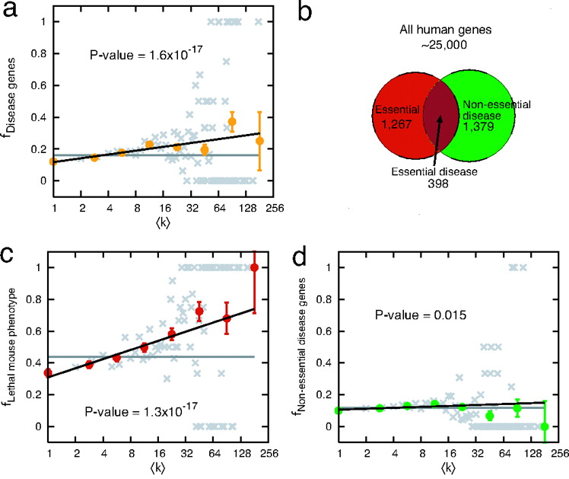
Centrality of Disease Genes
High degree proteins more likely disease associated
Essential genes are much more likely to be hubs
Kwang-Il Goh et al. PNAS 2007;104:8685-8690

Slide 18
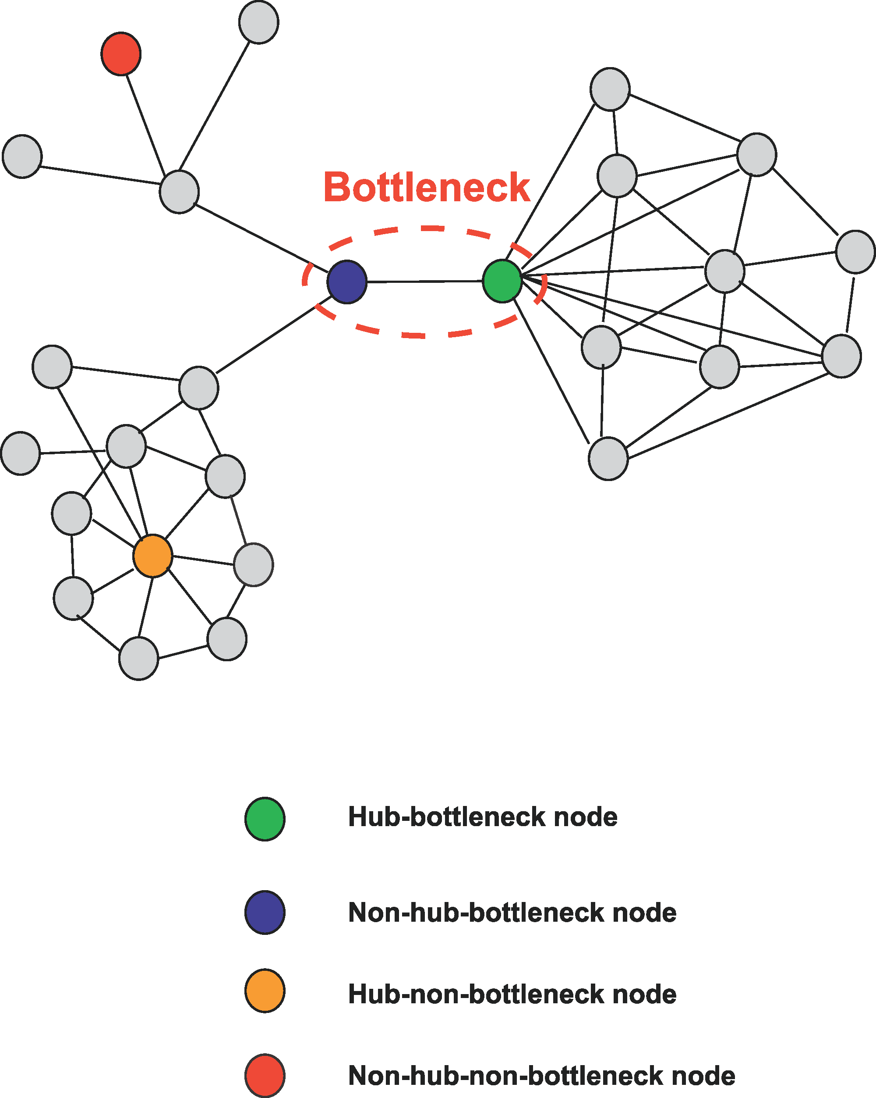
Graph Properties vs Biology
Bottlenecks: nodes with high centrality
Can have low or high degree
Centrality-Lethality Hypothesis
The more central a gene/protein is, the more likely it is essential
Yu et al Plos Comp Bio 2007

Slide 19
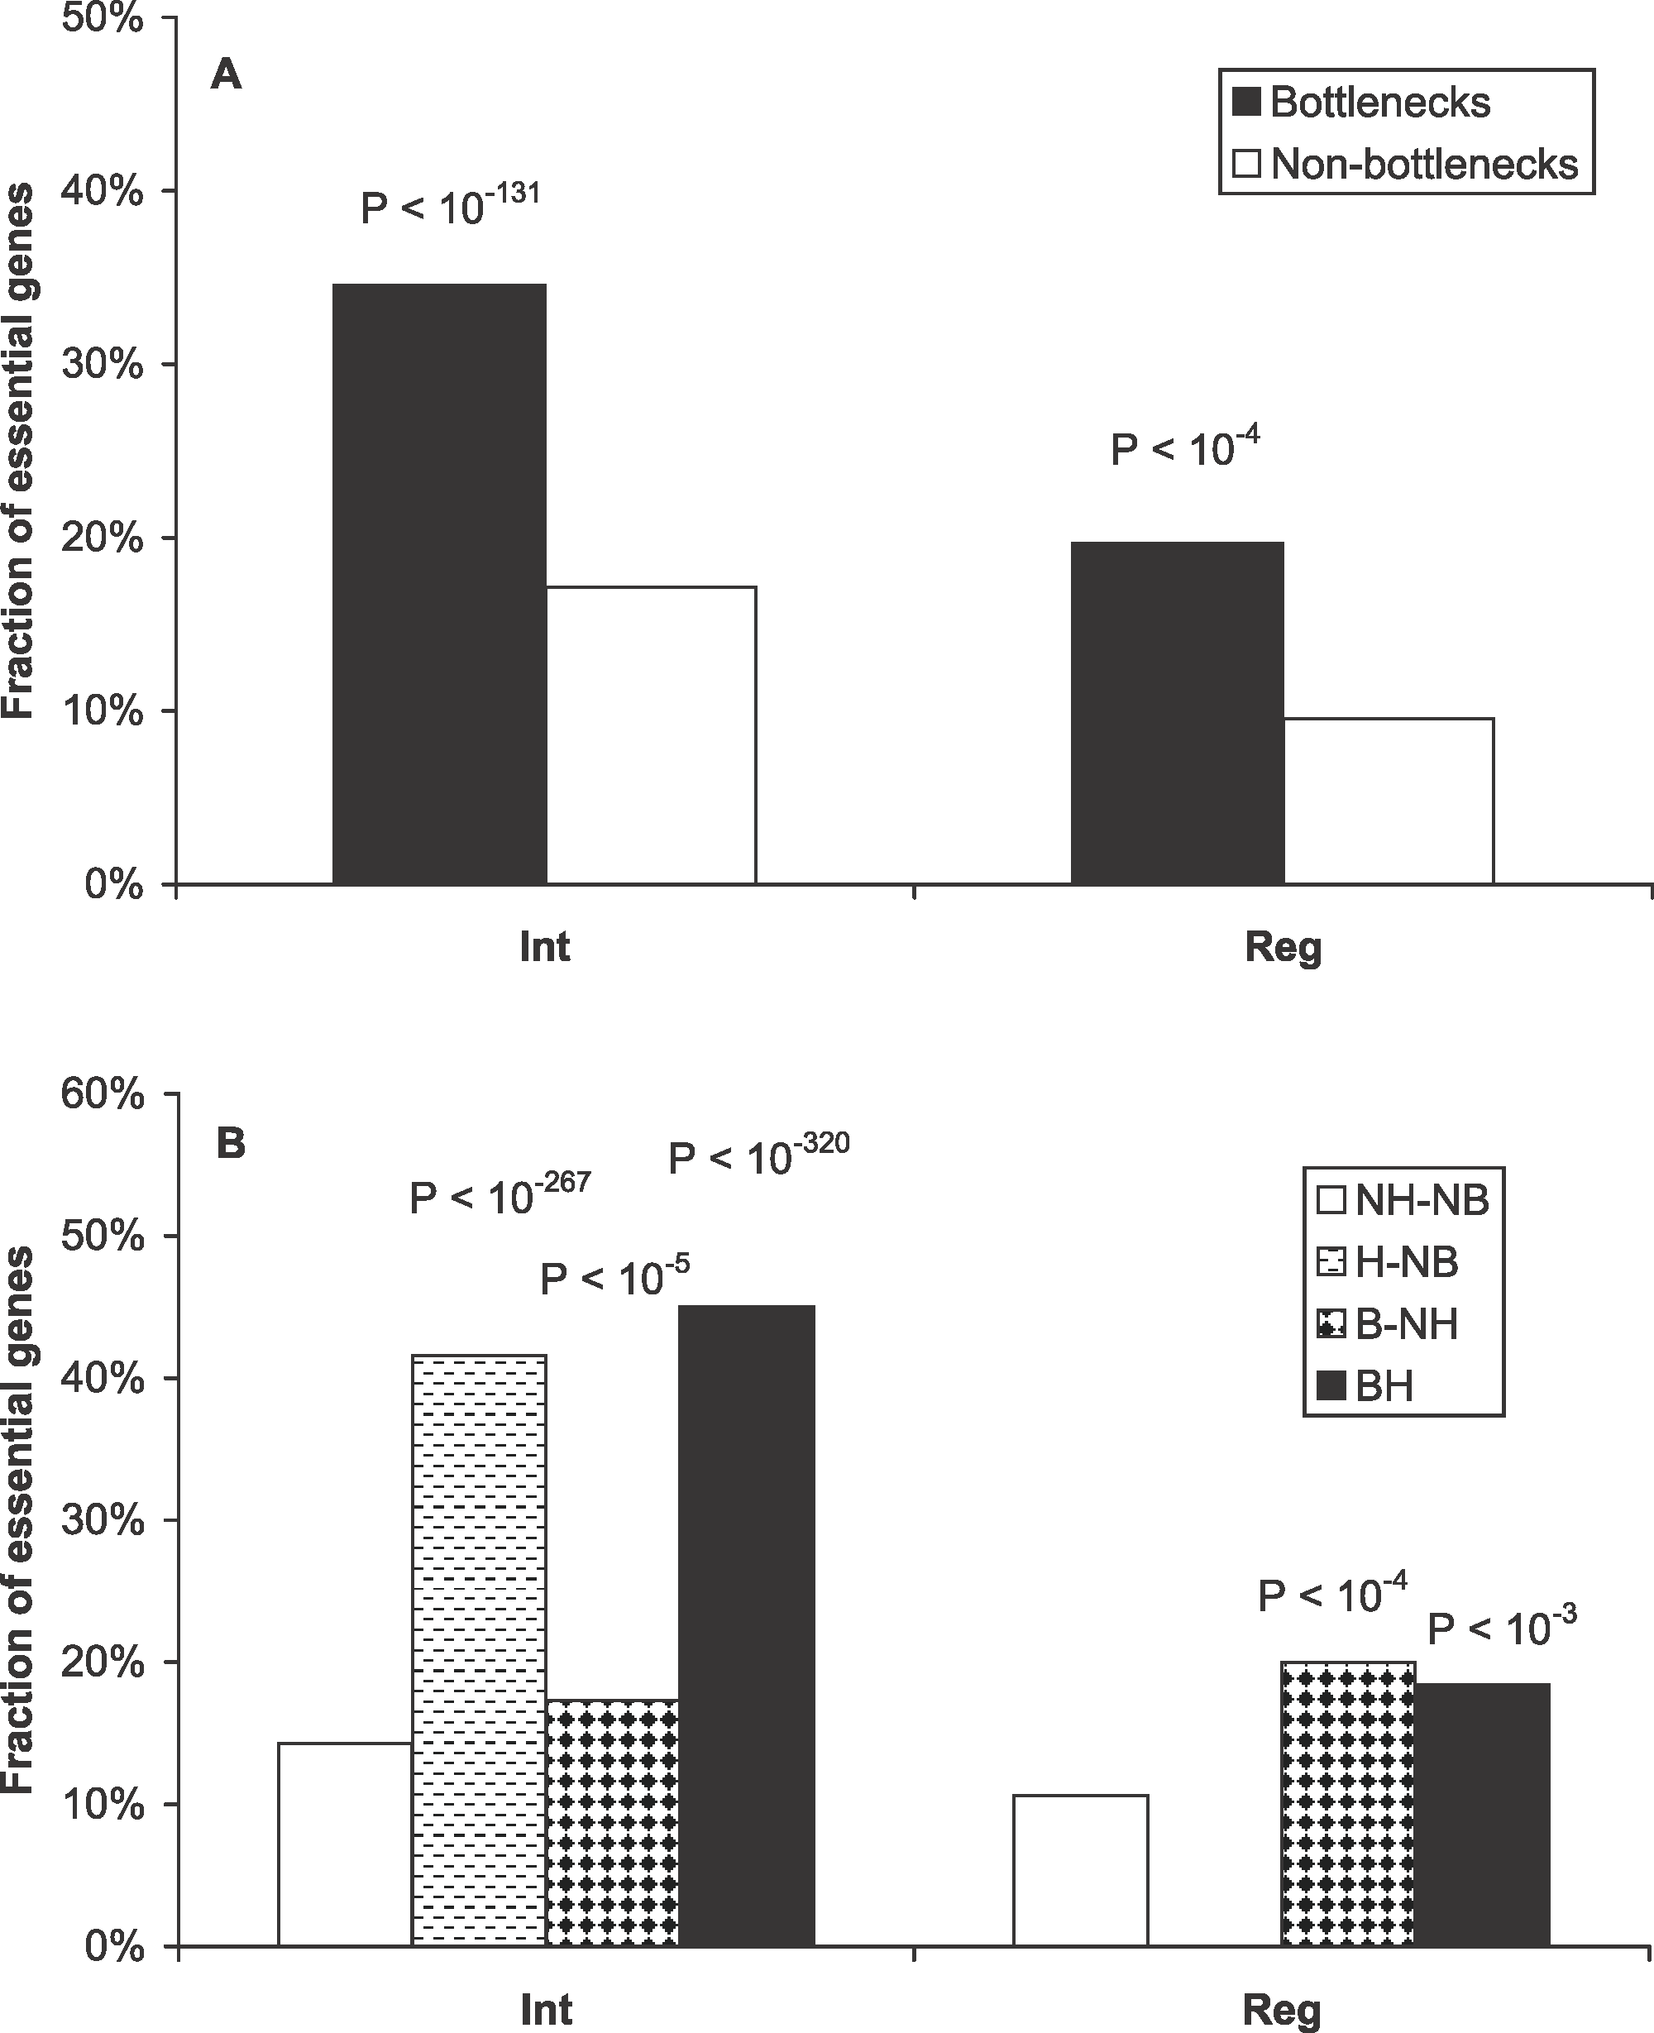
Graph Properties vs Biology
Bottlenecks: nodes with high centrality
Can have low or high degree
Centrality-Lethality Hypothesis
The more central a gene/protein is, the more likely it is essential
Yu et al Plos Comp Bio 2007
Notes:
A) Bottlenecks tend to be essential genes in both interaction and regulatory networks. p-Values measure the statistical significance of the different essentialities between bottlenecks and nonbottlenecks.
(B) Essentiality of different categories of proteins. NH-NB, nonhub–nonbottlenecks; H-NB, hub–nonbottlenecks; B-NH, nonhub–bottlenecks; BH, hub–bottlenecks. p-Values measure the statistical significance of the different essentialities between different categories of proteins against nonhub–nonbottlenecks using cumulative binomial distributions

Slide 20
Random Graphs
Comparing biological networks to random networks can provide biological insight
Original Erdos-Renyi (not widely used)
Given n vertices, all possible graphs with k edges – choose a graph at random
Exactly k edges
Erdos-Renyi (1960) / Gilbert (1959)
Given n vertices, two vertices are connected by an edge with a probability p
On average k edges, with the actual number following a probability distribution

Slide 21
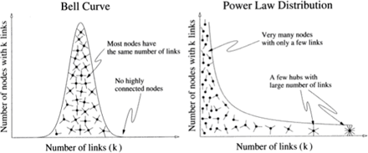
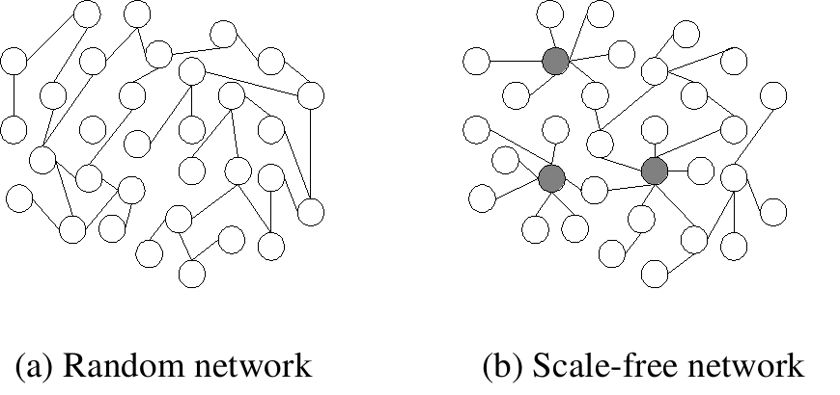
Random vs Scale Free Graphs
Implications for error tolerance:
P(deg=k) - k more likely to be higher in random network
More tolerant to random failures
“Attacks” targeting higher degree nodes more likely to be disruptive to function

Slide 22
Biological Networks have Hubs
PPI networks, regulatory networks and many other biological networks have hubs (Nodes of high degree)
PPI network hubs are older¹ and more essential² than random proteins in the network
1 Fraser et al, Science (2002)
2 Jeong et al, Nature (2001)

Slide 23
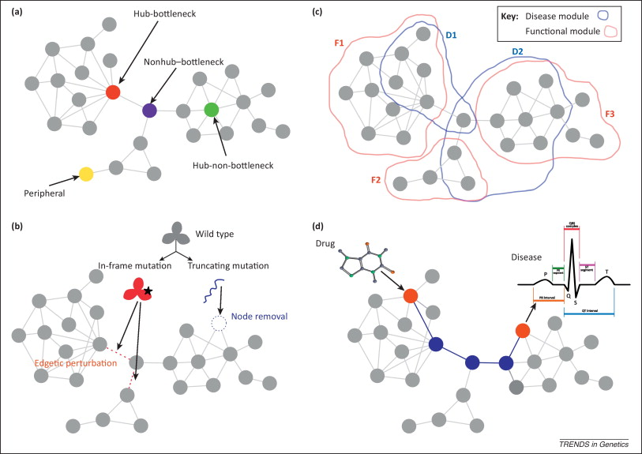
Network properties of human disease genes
Topology
Modularity
Perturbation
Environment
Furlong L. Human diseases through the lens of network biology Trends in Genetics 2013
Notes:
Different network attributes of disease genes are illustrated in a protein interaction network (PIN). (a) Nodes can be characterized by their role in the network, as peripheral, hubs, or bottlenecks. (b) The type of mutation of a protein (in-frame or truncating) leads to different perturbations in the PIN. Nonsense mutations, frame-shift mutations, and splice-site mutations lead to truncated proteins or completely destabilized proteins that can no longer maintain proper interactions with their protein partners. Such truncating mutations remove a node from the network and abolish all interactions. By contrast, subtle changes, such as single amino acid substitutions affecting binding sites or truncations that retain certain domains of the protein, may produce partially functional proteins that affect only a subset of their interaction partners. These in-frame mutations are referred to as edge-specific genetic, or edgetic, perturbations. (c) Different regions of a network can be identified according to the involvement of the nodes in common biological processes [functional (F) modules] or the same disorder [disease (D) modules]. Note that there is not a perfect overlap between functional and disease modules. In addition, different disease modules may overlap at least in part due to shared genetic determinants. (d) The interplay between environmental factors and genetic variation can be studied with network analysis. For example, the relation between the target of a drug and the protein associated with an adverse effect is modeled by calculating a distance measure in a PIN (edges highlighted in blue).

Slide 24
Algorithmic and Statistical Tasks Involving Graphical Models

Slide 25
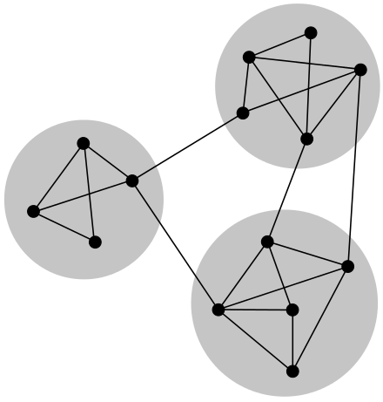
Algorithmic Problems on Graphs
Clique/motif counting
Module/community finding
Shortest path in a weighted or directed graph
Graph partitioning

Slide 26
Statistical Problems on Graphs
Hypothesis testing with networks
Determine if motif is over-represented
Compare behavior of groups of nodes
Test randomness of spatial distributions on the network
Compare properties of two networks
Theoretical null models often not available
Need background of random expectation
"observations" or scores in network data are not "independent" samplings from populations
Violates assumptions of many statistical tests

Slide 27
Statistical Problems on Graphs
Degree-preserving Permutation
Would you expect to see a statistic as extreme as t in a random network WITH THE SAME PROPERTIES?
Corresponds to an adjacency matrix where the row and column sums are the same.

Slide 28
Break

Slide 29
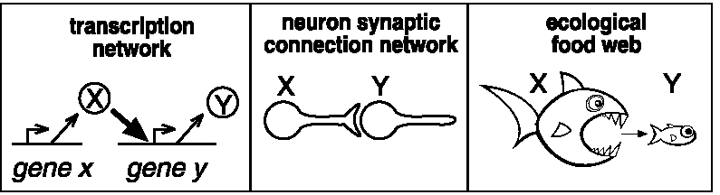
Example: Motif searches in 3 different contexts
How many motifs (connected subgraph topologies) exist involving three nodes?
If the graph is undirected?
If the graph is directed?

Slide 30
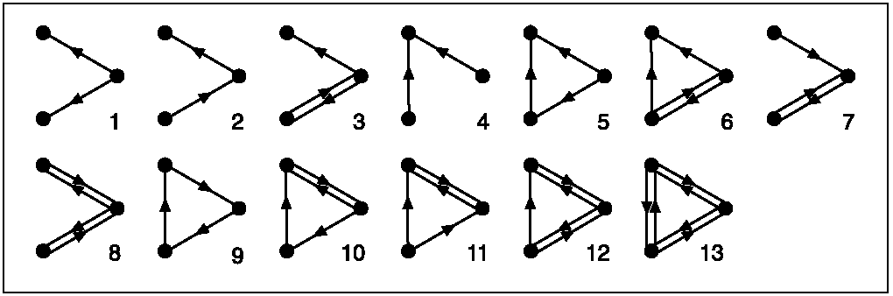
All 3-node directed subgraphs
What is the frequency of each in the network?
Are any of these motifs overrepresented? (would suggest function)

Slide 31
Outline of the Approach
Search network to identify all possible n-node connected subgraphs (here n=3 or 4)
Get # occurrences of each subgraph type
The significance for each type is determined using permutation testing, in which the above process is repeated for many randomized networks (preserving node degrees– why?)
Use random distributions to compute a p-value for each subgraph type. The “network motifs” are subgraphs with p < 0.001 (why?)

Slide 32
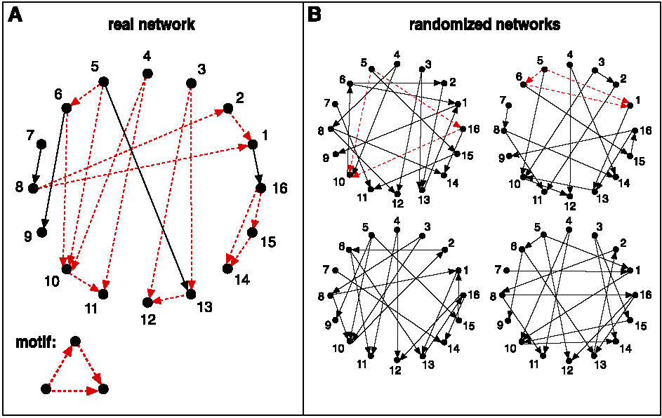
Schematic view of network motif detection
Networks are randomized preserving node degree

Slide 33
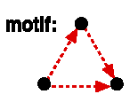
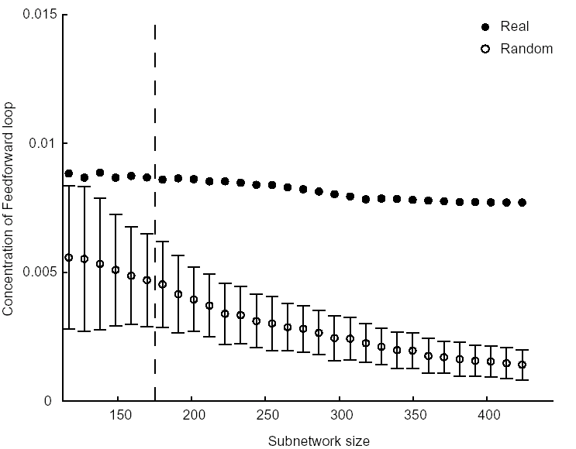
Concentration of feedforward motif:
(Num. appearances of motif divided by all 3 node connected subgraphs)
Mean+/-SD of 400 random subnetworks

Slide 34
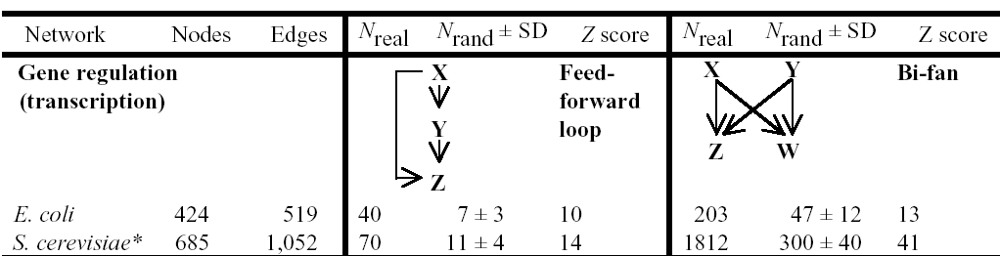
Transcriptional network results

Slide 35
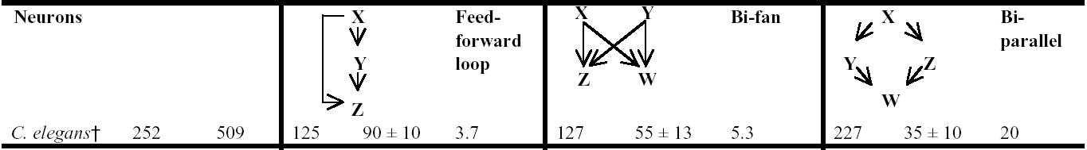
Neural networks

Slide 36
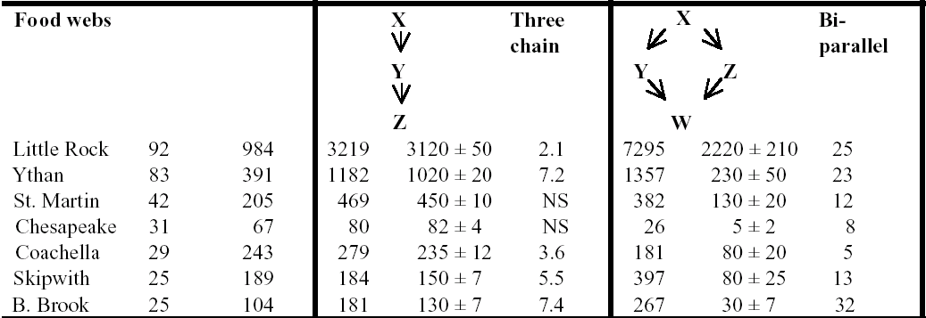
Food webs

Slide 37
Interesting questions
Which networks have motifs in common?
Which networks have completely distinct motifs versus the others?
Does this tell us anything about the design constraints on each network?
E.g., the feedforward loop may function to activate output only if the input signal is persistent (i.e., reject noisy or transient signals) and to allow rapid deactivation when the input turns off
E.g., food webs evolve to allow flow of energy from top to bottom (?!**!???), whereas transcriptional networks evolve to process information
Notes:
feed forward loop & bifan commonly act as AND/OR gates depending on activating/inactivating activity of nodes
Top-down control => Abundance/biomass of lower trophic levels depends on effects of consumers at higher trophic levels

Slide 38
Discussion of Biological Networks in Practice

Slide 39
Properties of Biological Networks
Scale Free
Generally see a small number of highly connected hubs and a much larger number of less connected nodes
Fault tolerance – essential nodes less likely to be “attacked” by random error
Small world
Most nodes in biological networks are not that distant from one another
Evolutionary advantage – deleting a node generally doesn’t greatly increase the mean shortest path length
Guilt-by-association
Neighboring nodes in biological networks are usually involved in the same biological function

Slide 40
Examples of Biological Networks
Protein-protein interaction
Metabolic
Co-expression
Regulatory
Genetic Interaction
Difference Networks
Abstract

Slide 41
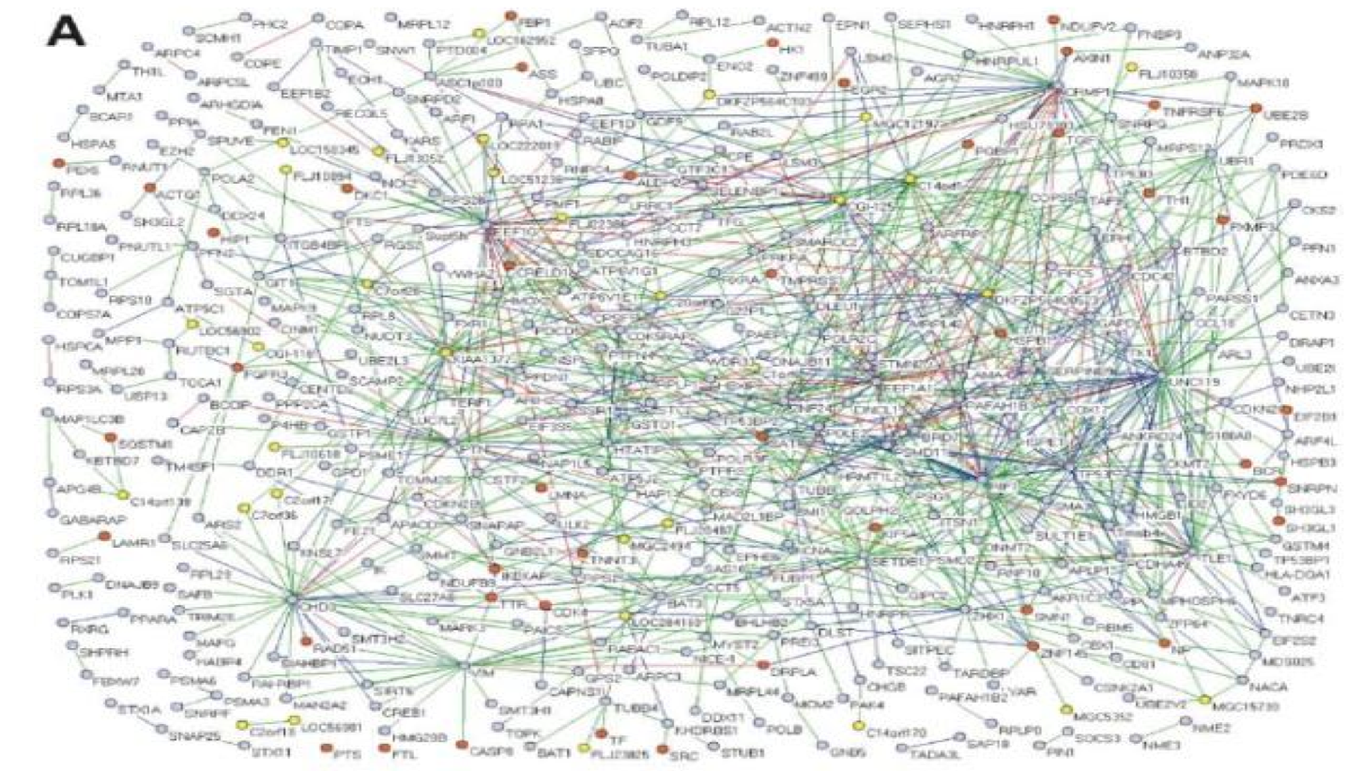
Protein Protein Interaction Network
Generated from Y2H data
MacArthur et al., PLoS ONE 3: e3086 (2008)

Slide 42
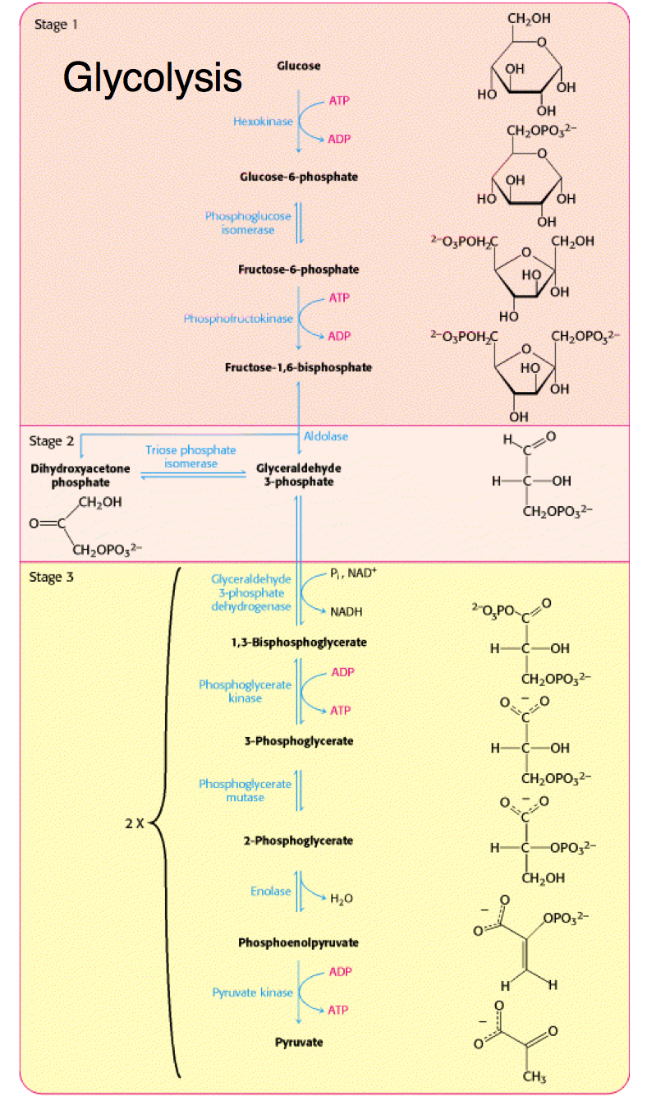
Metabolic Networks
Substrate
Reaction
Substrate
Reaction
Substrate

Slide 43
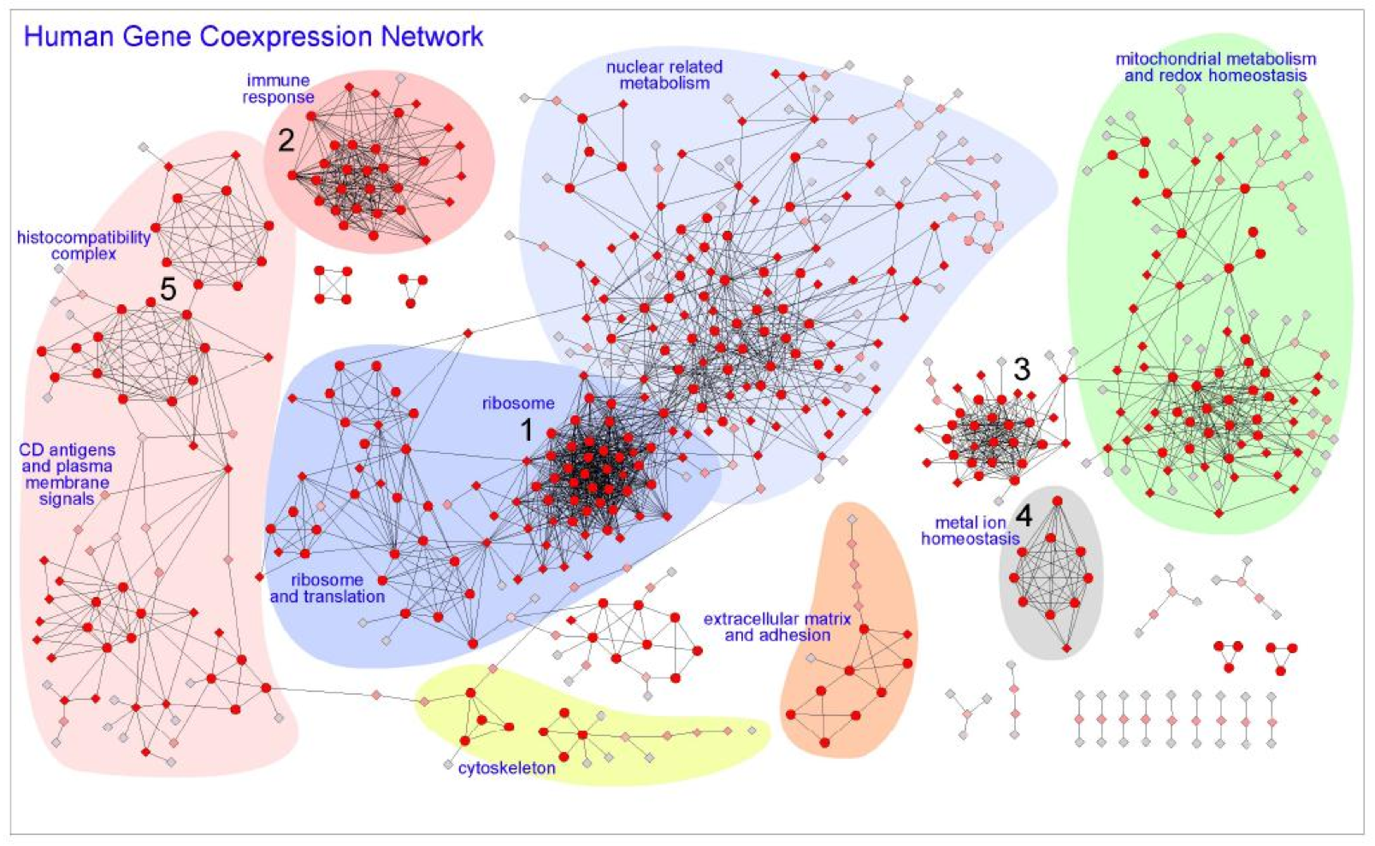
Hi-Fi Human Co-expression Network
Generated from microarrays on a panel of healthy normal tissues
3327 gene-nodes and 15841 coexpression-links
PLoS One. 2008

Slide 44
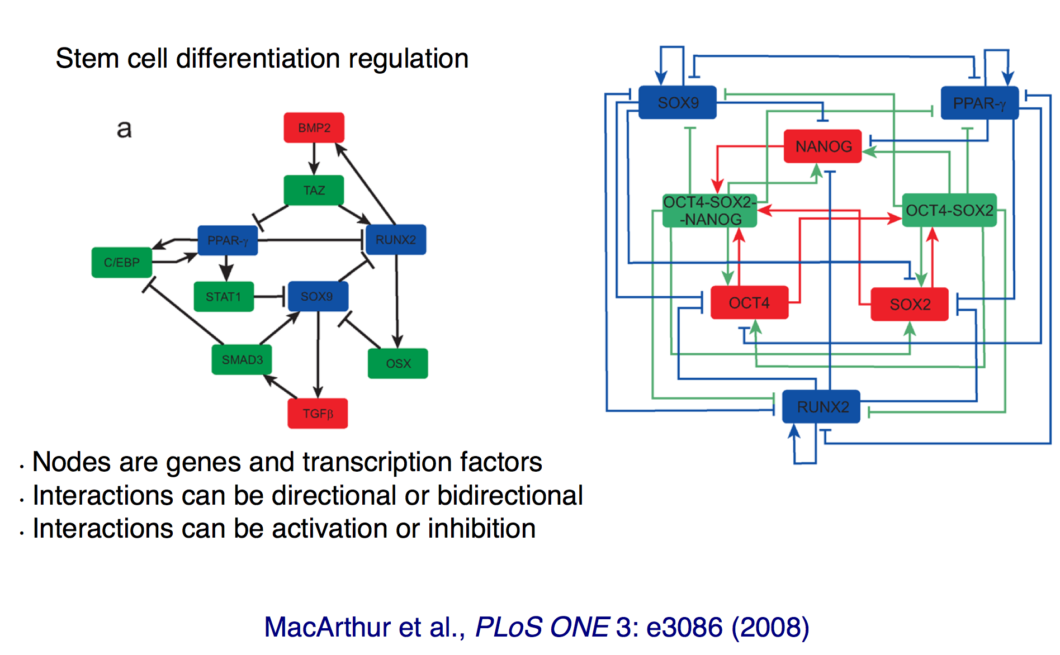
Gene Regulatory Network

Slide 45
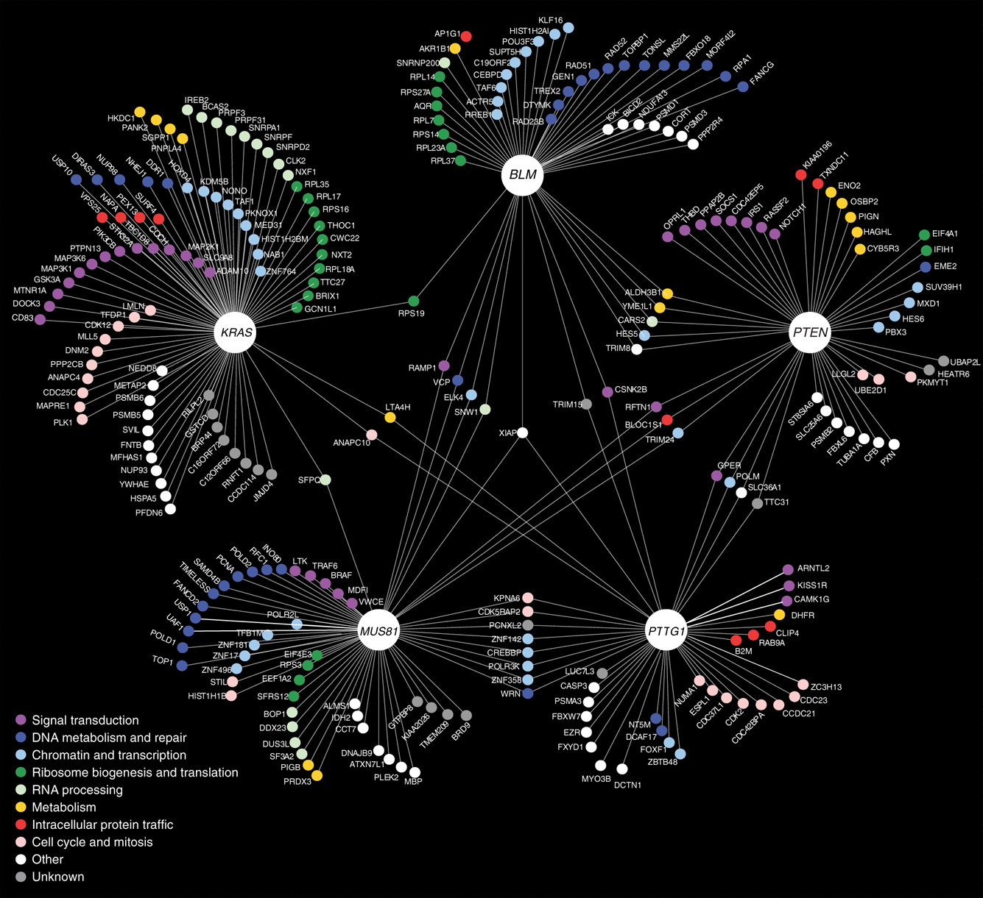
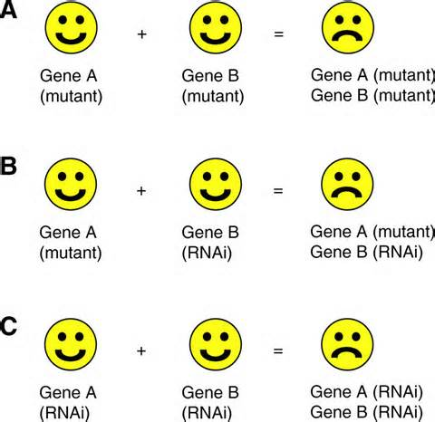
Genetic Interaction Network
Vizeacoumar et al Molecular Systems Biology (2013)
Application: Identify possible synthetic lethal interactions
Notes:
RNAi = RNA interference

Slide 46
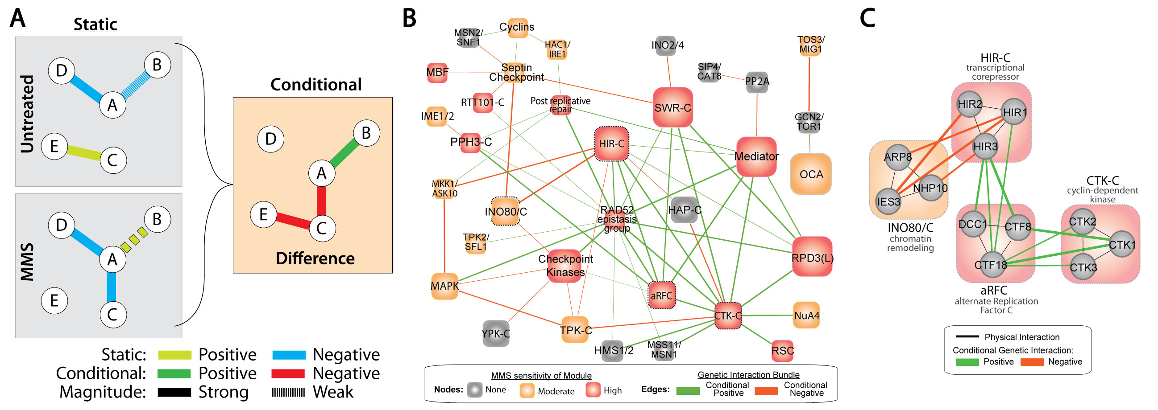
Difference Networks
Edges represent changes between different experimental conditions
Application: Compare how two distant species respond to a common stimulus

Slide 47
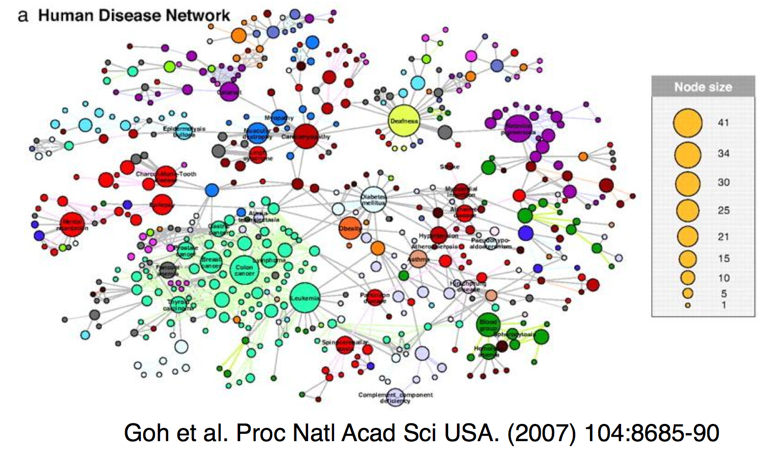
Diseaseome
Started from a bipartite graph
nodes represent genes and diseases
edges connect genes to diseases
Notes:
This is a collapsed view – diseases are linked by an edge if they share a gene. Node size corresponds to number of disease-associated genes

Slide 48
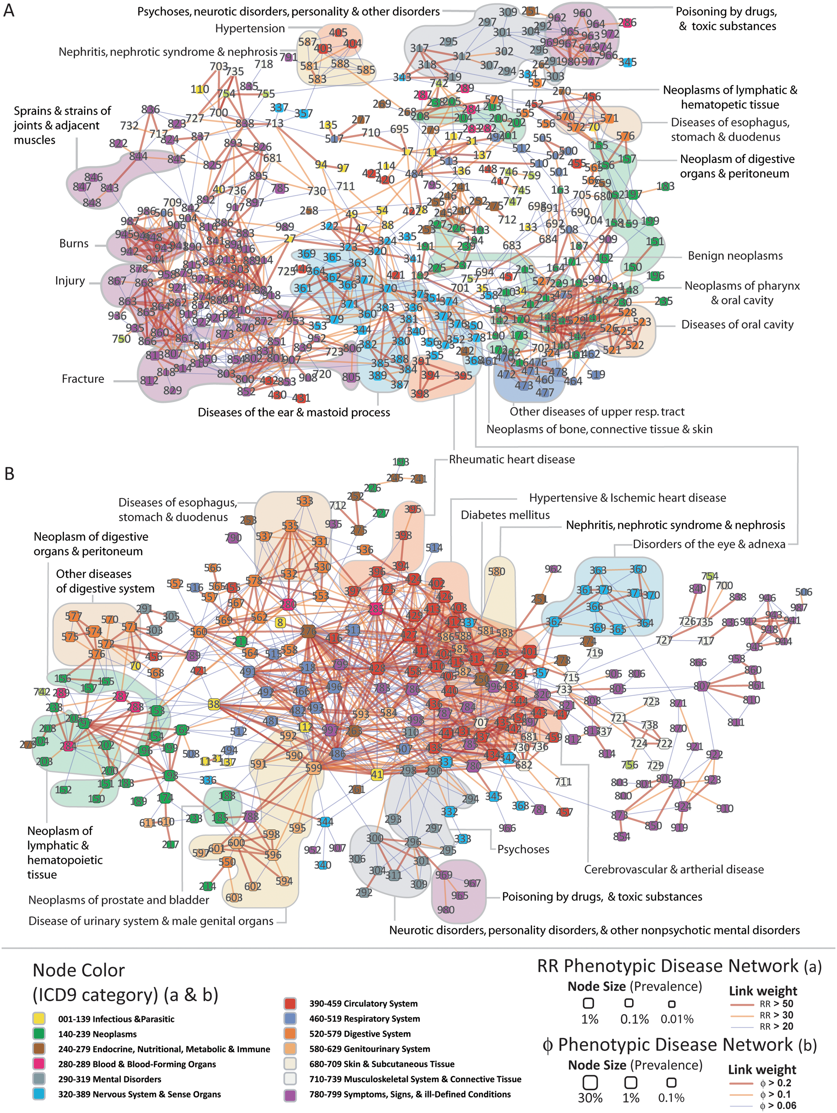
Phenotypic Disease Networks (PDNs).
correlations obtained from the disease history of more than 30 million patients
patients develop diseases close in the network to those they already have
the progression of disease is different for patients of different genders and ethnicities;
patients diagnosed with more highly connected diseases tend to die sooner
Hidalgo et al. PLoS Comp Bio 2009

Slide 49
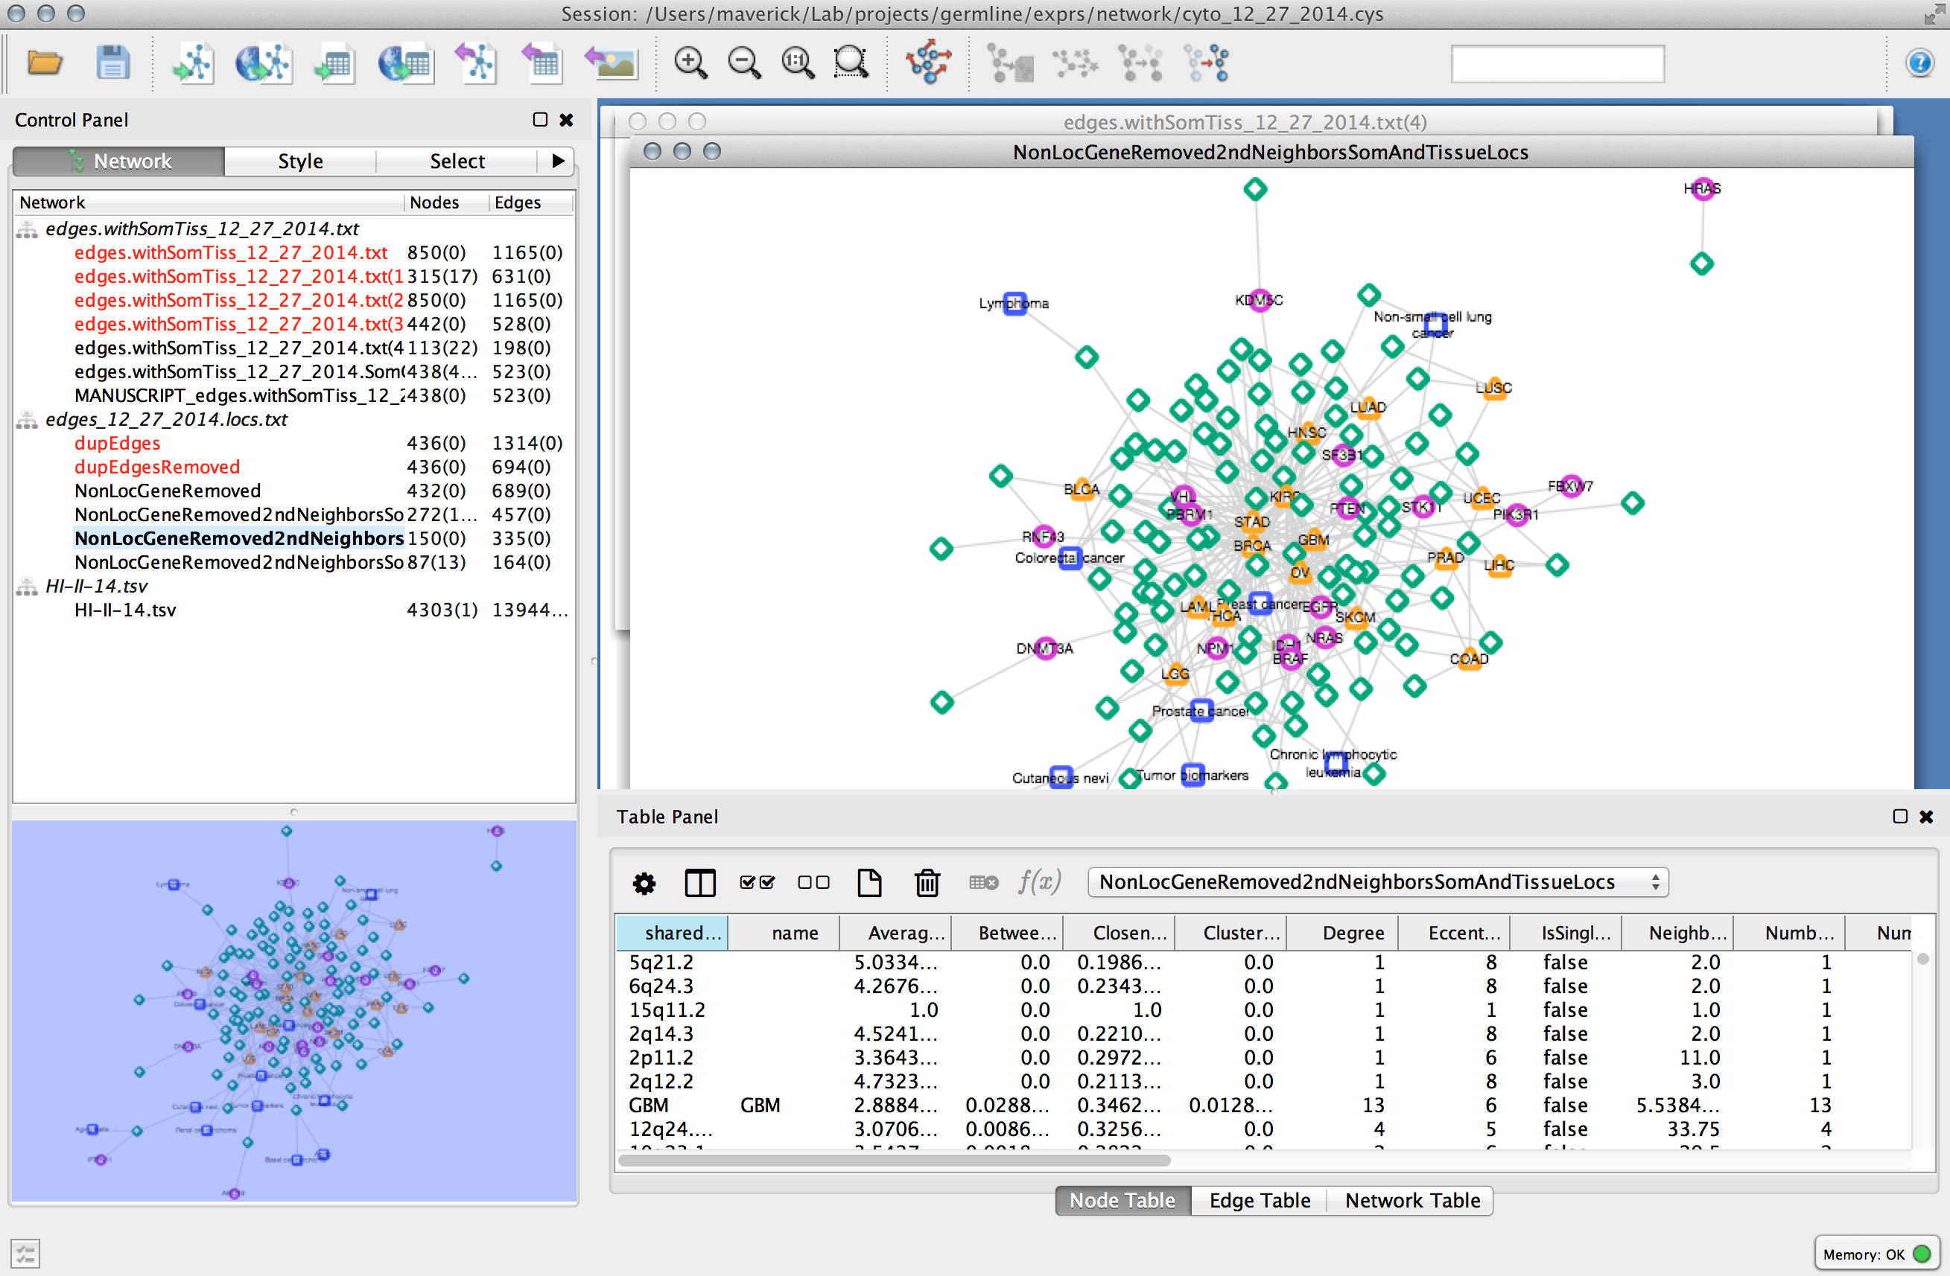

Visualizing / Analyzing Graphs
Cytoscape
iGraph (R)
NetworkX (Python)

Slide 50
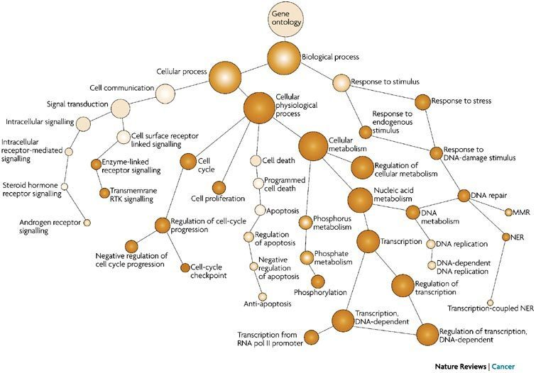
Ontologies
Define a hierarchy among objects
Gene Ontology (GO)
Curated from scientific literature
Other examples
Disease – symptom relationships
Organ – tissue – cell-type relationships

Slide 51
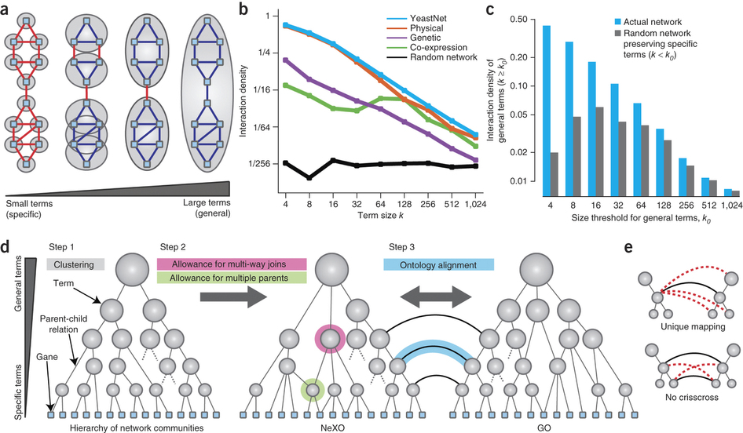
Constructing Ontologies from High-throughput Data

Slide 52
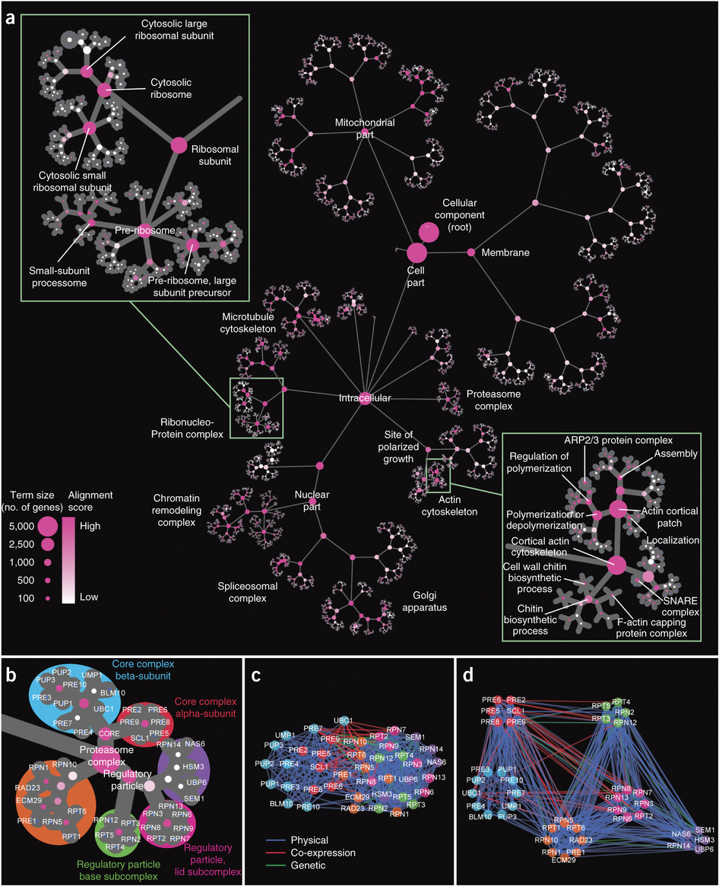
NEXO for Yeast
Nature Biotechnology (2013)

Slide 53
Sources for Biological Network Data
Literature
Interaction databases
STRING
MINT
HPRD
MIPS
BIND
GRID
DIP
HumanNet / YeastNet
Pathway Databases
Pathway Commons
Biogrid
NCBI PID
Reactome
Gene Ontology
High-throughput experiments
Y2H – binary interactions
APMS – protein complexes

Slide 54
Challenges in Biological Network Analysis
Incomplete data
We don’t have the tools to exhaustively measure the interactome
Static representation of a dynamic system
Even static representation may differ between environments
Biases inherent in how network was constructed
More studied proteins tend to have more interactions

Slide 55
Excercises

